Slide 1
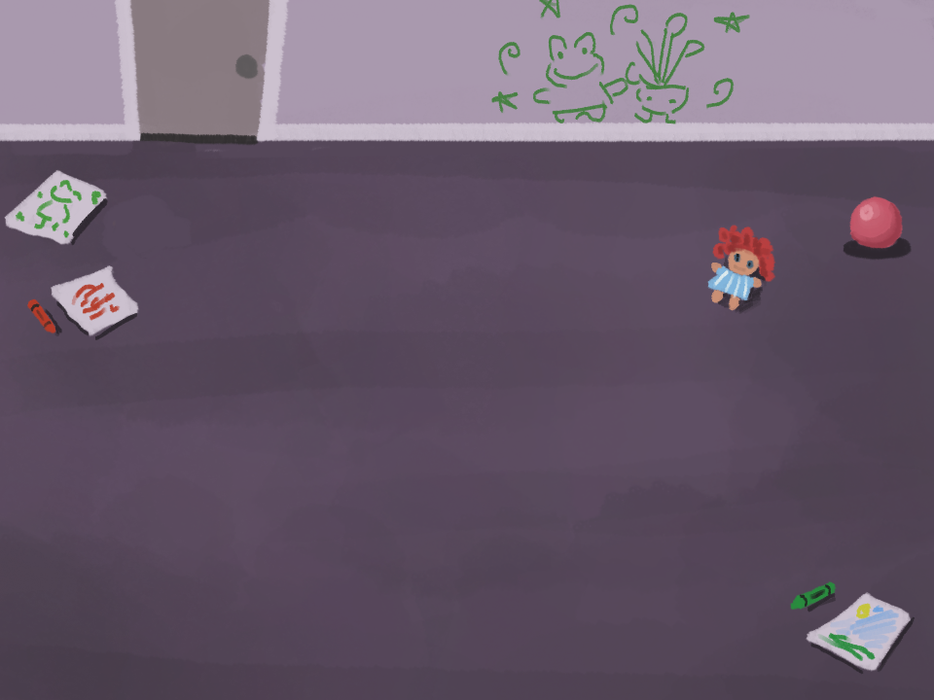
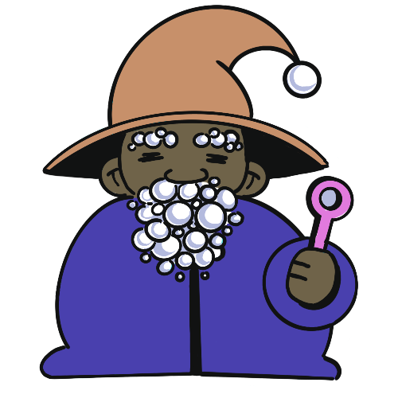
Bubble Wizard
By Caleb, Ishara, Alec, Caiden, and Jaxon

Slide 2

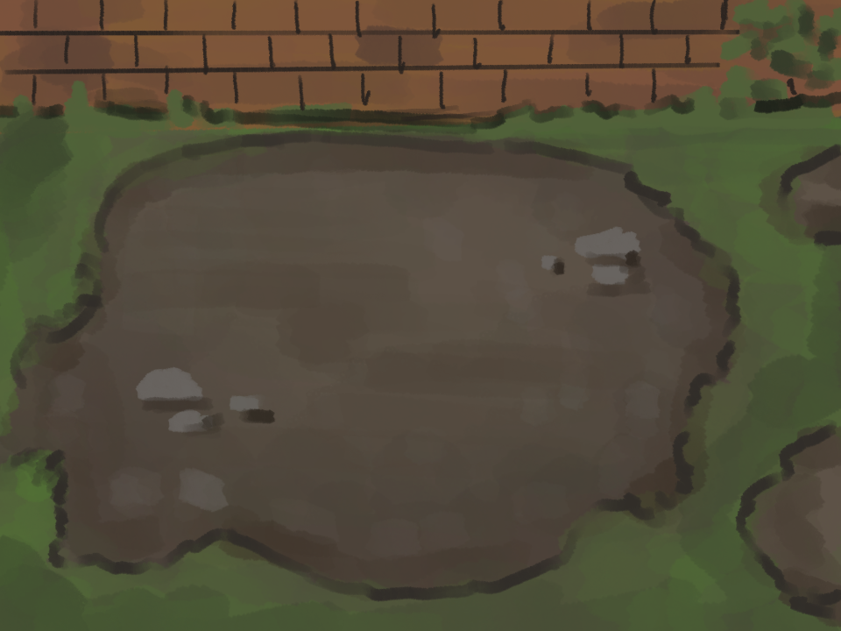




Gameplay
A top-down RPG where players control the titular Bubble Wizard, a powerful spellcaster capable of entering the dreamworld using his magic bubble wand
While the Bubble Wizard tries to help those around him, the job also has its perks- he can keep anything he finds in their heads. This time around he’s trying to find all the elements he needs for a perfect bubble bath.
+
+

Slide 3
